Slide 1

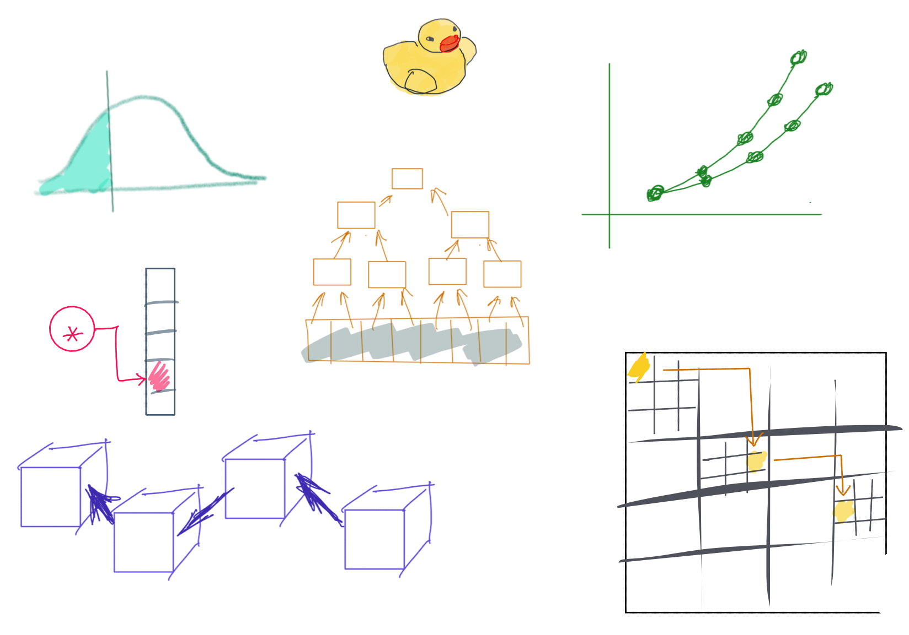

Slide 2
CSS342 Data Structures, Algorithms, and Discrete Mathematics (I)

Slide 3


COVID Rules
All materials and class sessions are available online
Do not come to in-person class if not feeling well or tested positive
And please notify instructor immediately if tested positive
Please wear mask for close-up conversation in person
Instructor might wear mask during class
I will answer questions after class outside the building with mask on

Slide 4
The WHO

Slide 5
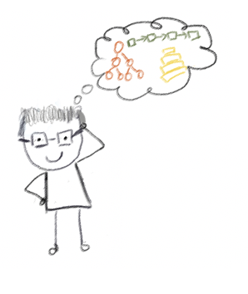
Lecturer
Peng Du
High performance computing
Matrix stuff, Matrix Factorization, etc
Cloud & Edge computing
Kubernetes, docker, etc.
Part-time Teaching
CSS 342 (2019)
CSS 143 (2020, 2021)

Slide 6





Lecturer
Day job: Cloud & Edge Computing
https://github.com/CentaurusInfra

Slide 7



Why “goose”?
Photography
https://www.instagram.com/fatgoooose
Working
https://github.com/a-teaching-goose
Rally Racing
Comic design and drawing by @percima.art

Slide 8
The WHAT

Slide 9
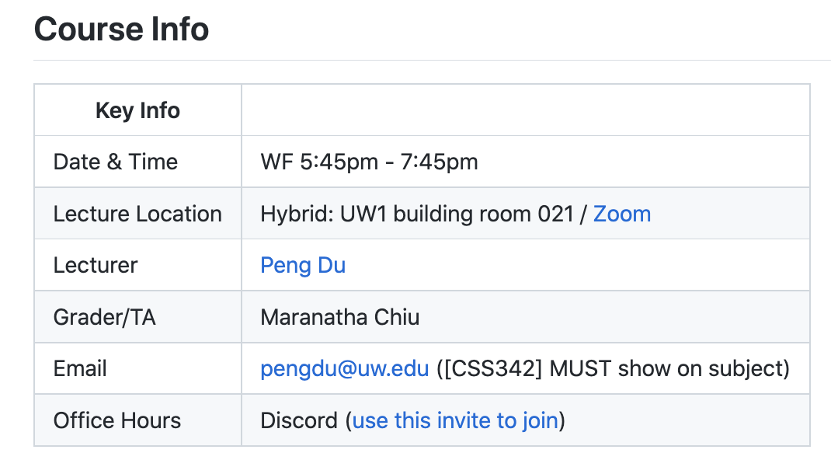
Class Info
Syllabus
https://github.com/a-teaching-goose/CSS342A-2022-Spring
You need to join our class GitHub Team (private) to see this

Slide 10
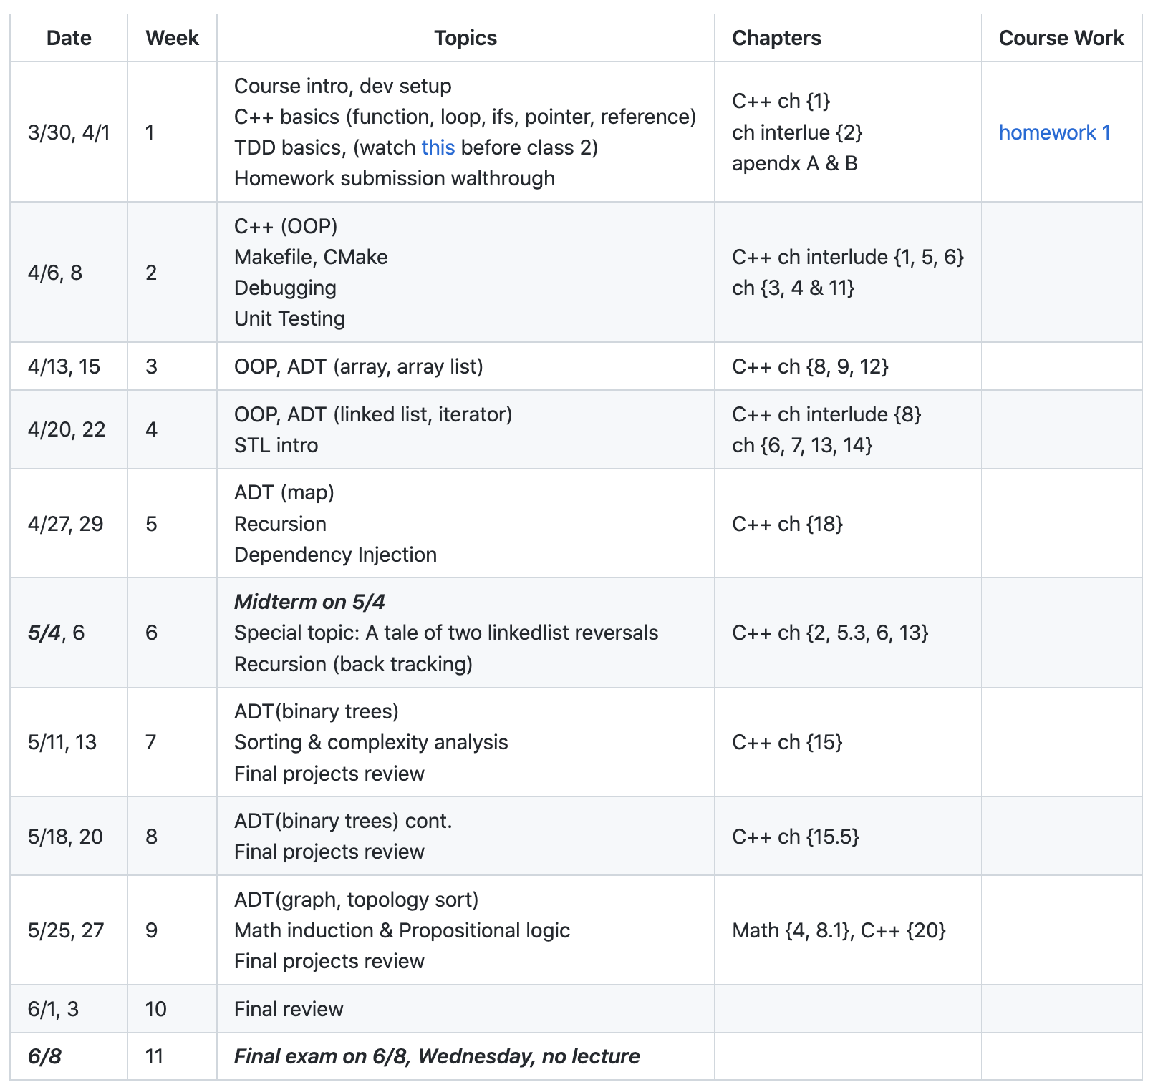
Class Info
subject to change
https://github.com/a-teaching-goose/CSS342A-2022-Spring#tentative-schedule
How do I know though?

Slide 11
Class Materials
Learn to learn
Write Solid Code
Programming Languages
C++
Data Structure
Array
List
Map (Dictionary)
Tree
Graph (maybe)
Algorithm
Search
Sort
Recursion
Complexity analysis
Computation Theory
Math induction & Propositional logic

Slide 12
Class Materials
CSS 143

Slide 13

C++
Basics:
Function
Loop
If-else
Primitive types
int, float
array
struct
Intermediate:
Template
Class
Pointer (new & delete)
Reference
STL containers
Advanced:
OOP
Smart pointers
Exception
File I/O
Makefile

Slide 14
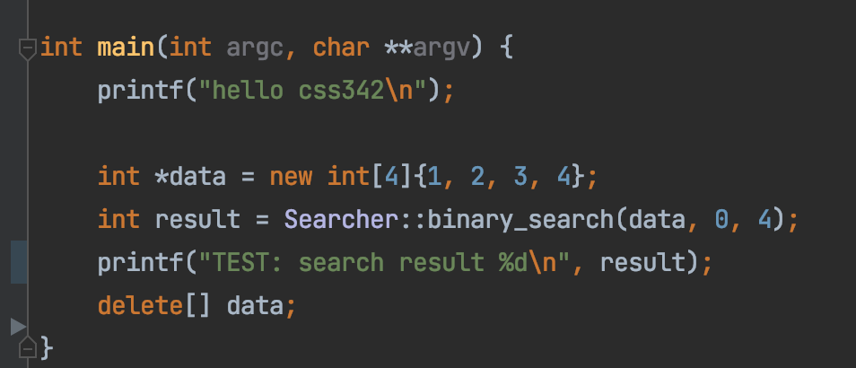
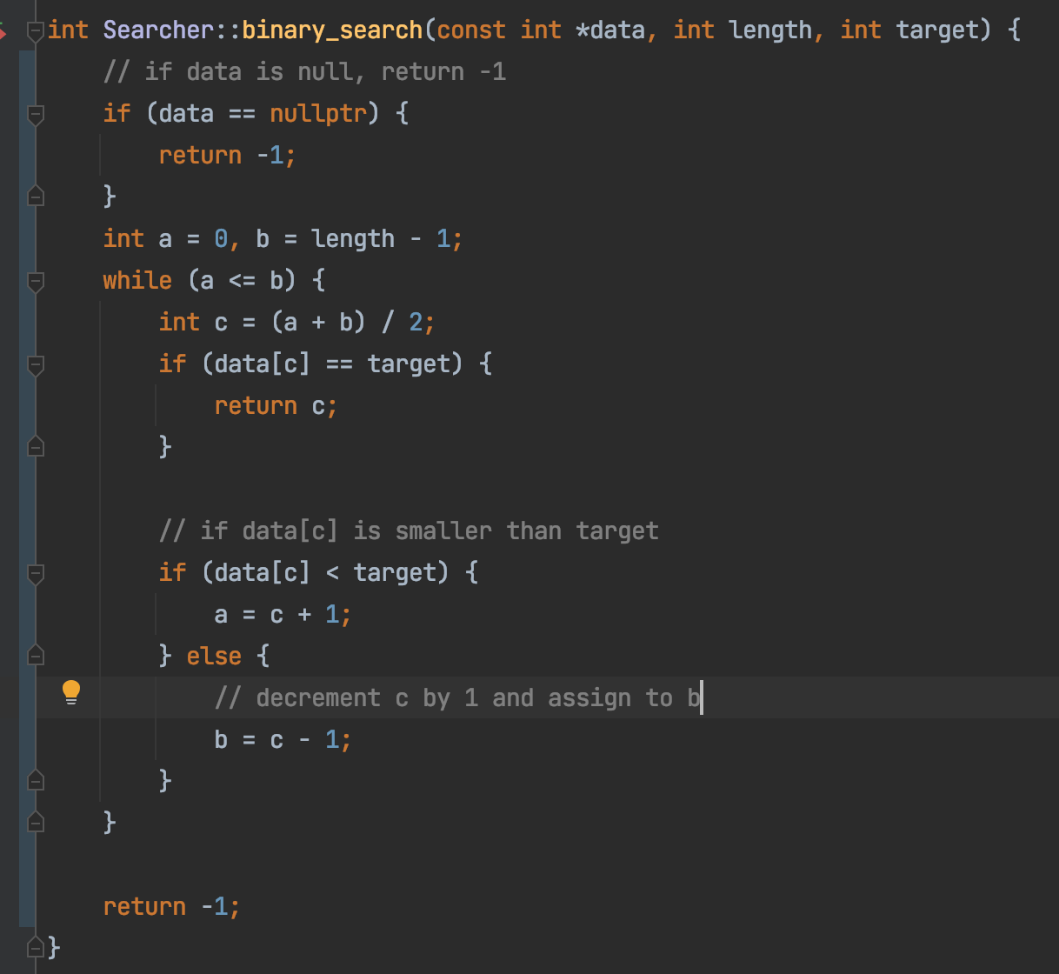
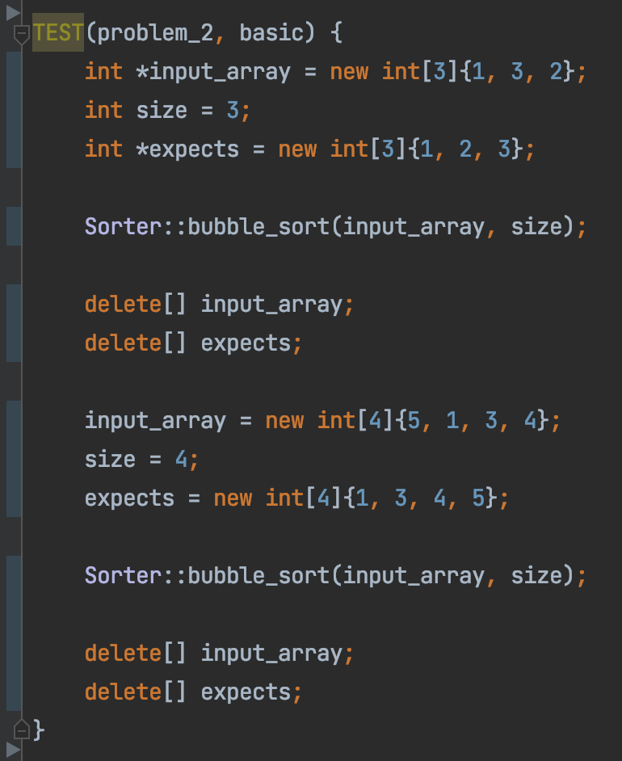
Write Solid Code

Slide 15

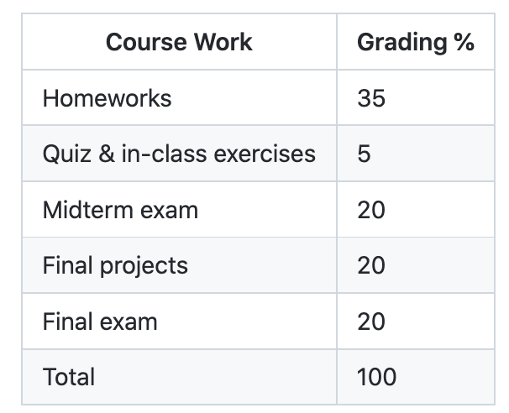
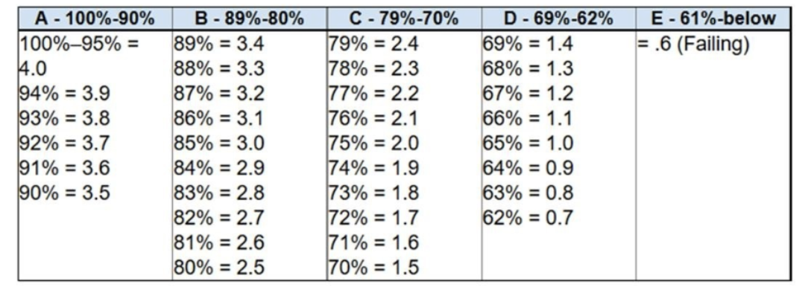
Grading
https://github.com/a-teaching-goose/CSS342A-2022-Spring#coursework-distribution

Slide 16

In-person vs Online
“Best effort” in-person
> 50% in-person session
In-person attending is not required
All class will be recorded to the best effort
Online sessions
Covid
Coding demos & Code-along
All materials (PPT, code, video, exams) will be available online

Slide 17
Homework, Tests, Exams
Weekly homework
15-min Quiz, mostly coding question
1 midterms (online, incremental, ~1.5 hr)
1 Final (online, comprehensive, ~2 hr)
No late assignment will be accepted
Exception is very very rarely given
No make-up exam

Slide 18

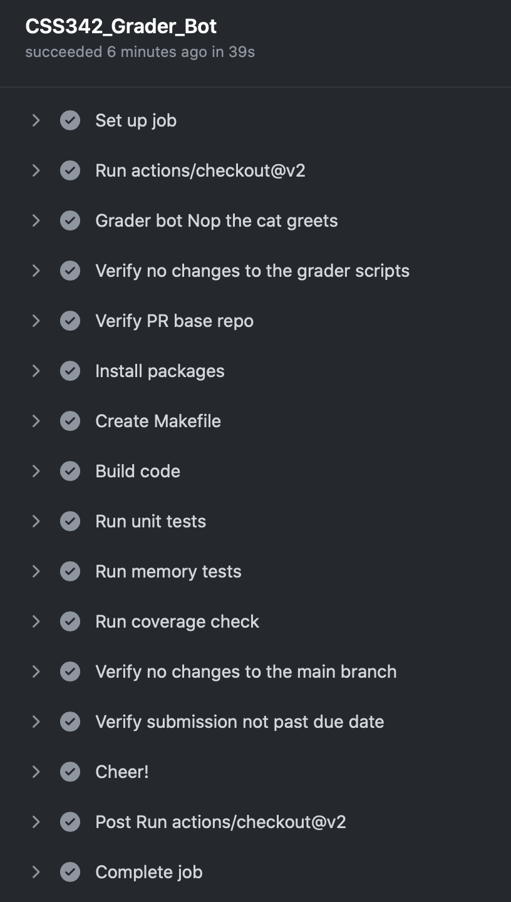
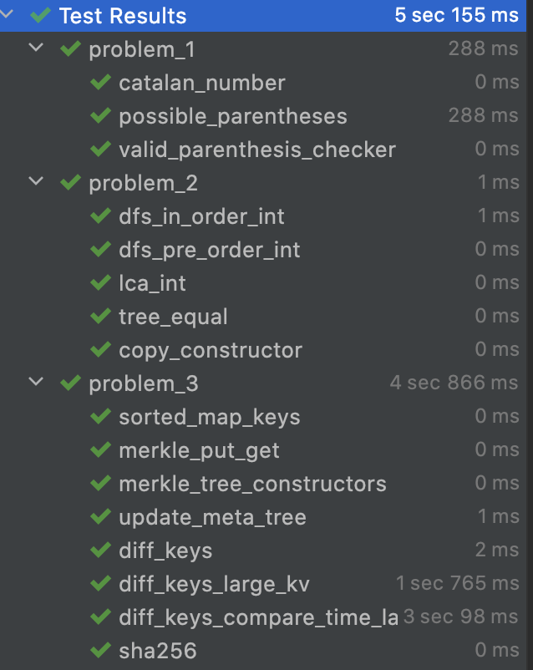
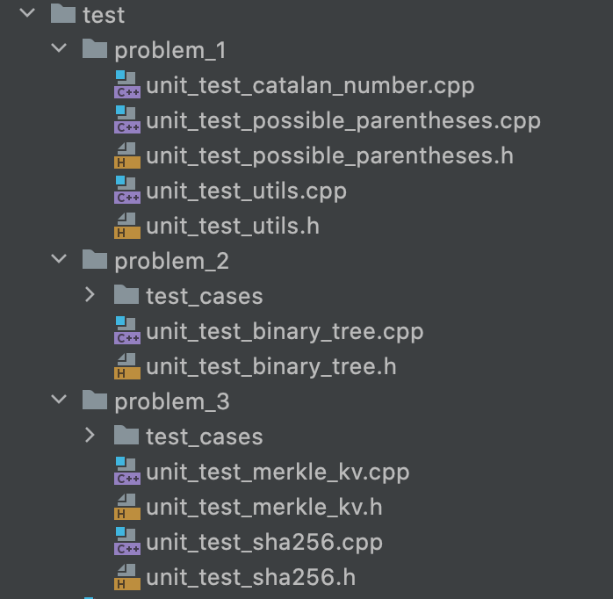
Homework & Final projects
Automated check
Homework entirely on GitHub
All test cases provided
Submission via GitHub Pull Request
A robot (set of scripts) called “Nop the cat” does validation
Once all work is done locally
Test cases

Slide 19
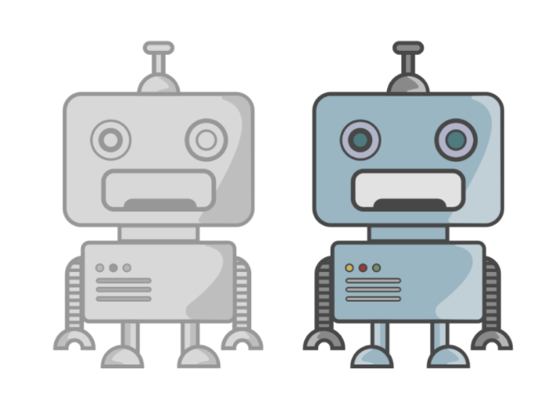
Homework & Final projects
Fun (new) problems !!
Compound Interest (C++, floating point numbers)
Latency evaluation via percentile (C++)
Media store Inventory manager (OOP)
Testing std::out (TDD)
Sudoku Solver (recursion, backtracking)
Matching parenthesis of ”any” size (recursion)
”SAGA” message queue pattern for distributed system
Merkle tree (used in Github itself and similar idea in Blockchain)
And some common technical interview problems

Slide 20
The HOW

Slide 21
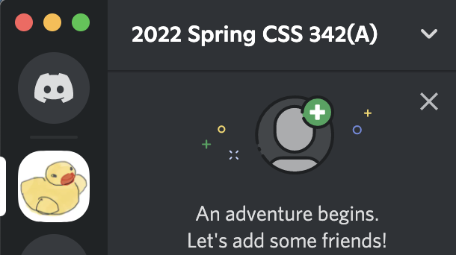
Why the “rubber duck”?
Think out LOUD
Talk to the Duck
https://rubberduckdebugging.com
https://www.youtube.com/watch?v=huOPVqztPdc

Slide 22

Code Together
Code together during class session
Instruction demo
Homework walkthrough
Have a ”read-to-go” dev environment ready
IDE, debugger, git/github
Volunteer to run a code-along session?

Slide 23
Schedule Ramping up
“I’ve forgotten what I learned in 142/143”
Week 1
(this week)
Week 2
Week 3
Week 4
C++
Dev env (IDE, Vim, debugging)
Source control (Git & Github)

Slide 24
Tips for Success
Good Sleep
Maintain good sleep
“Sleep” on it
Study Smart
Make small improvement everyday
Tracking progress (write log, blog, vlog…)
Practice, practice, practice (read/write code)
Communicate
If you have trouble with something, very likely you are not the only one
Ask the instructor (on Discord)
mistake, stuck → “opportunity to improve”

Slide 25
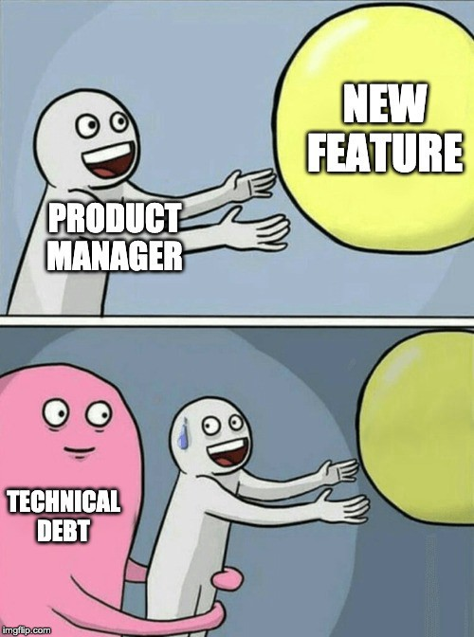
Technical Debt Log
Technical Debt: Topics that you should’ve understood but not yet.
Keep a journal throughout the semester (somewhere only you can see, e.g. a private GitHub repo)
Date | Debt Topic | Plan To Fix | Status
Bring this to 1:1 discussion
Weekly log throughout semester 10pt → extra credit on Final

Slide 26

Plagiarism
Do the work yourself
It’s okay to get help from other people’s work/idea/code, but:
Give credit : “I was using […] for help in this homework”
Violation will be reported to department
School takes this VERY VERY seriously

Slide 27
Is it Plagiarism?
Case 1:
Stuck for 2 hours. Found an solution on stackoverflow.com. Copied answer into homework without changes and submit.
Plagiarism!!
Instead, understand the idea from the help source, and then write the code yourself. Better yet, make some improvement.

Slide 28
Is it Plagiarism?
Case 2:
Had discussion with friends, classmates, TA and/or instructor. Write code based on your understanding.
NOT Plagiarism!!

Slide 29
Is it Plagiarism?
Case 3:
Ask homework at paid-for-help service, someone there wrote the code, and you paste that code into submission
Plagiarism!!
Instead, understand the idea from the help source, and then write the code yourself. Better yet, make some improvement.

Slide 30
The Dev Environment

Slide 31
Tooling
OS:
Windows, Linux, Mac
IDE/Editor:
Visual studio, VS Code, Clion, Xcode, Atom, etc.
VIM, Emacs
Makefile, CMake
Online Editor
Testing:
A review by Clion
Googletest
Source Control
Git, www.github.com

Slide 32
Tooling
OS:
Windows, Linux, Mac
IDE/Editor:
Visual studio, VS Code, Clion, Xcode, Atom, etc.
VIM, Emacs
Makefile, CMake
Online Editor
Testing:
A review by Clion
Googletest
Source Control
Git, www.github.com

Slide 33
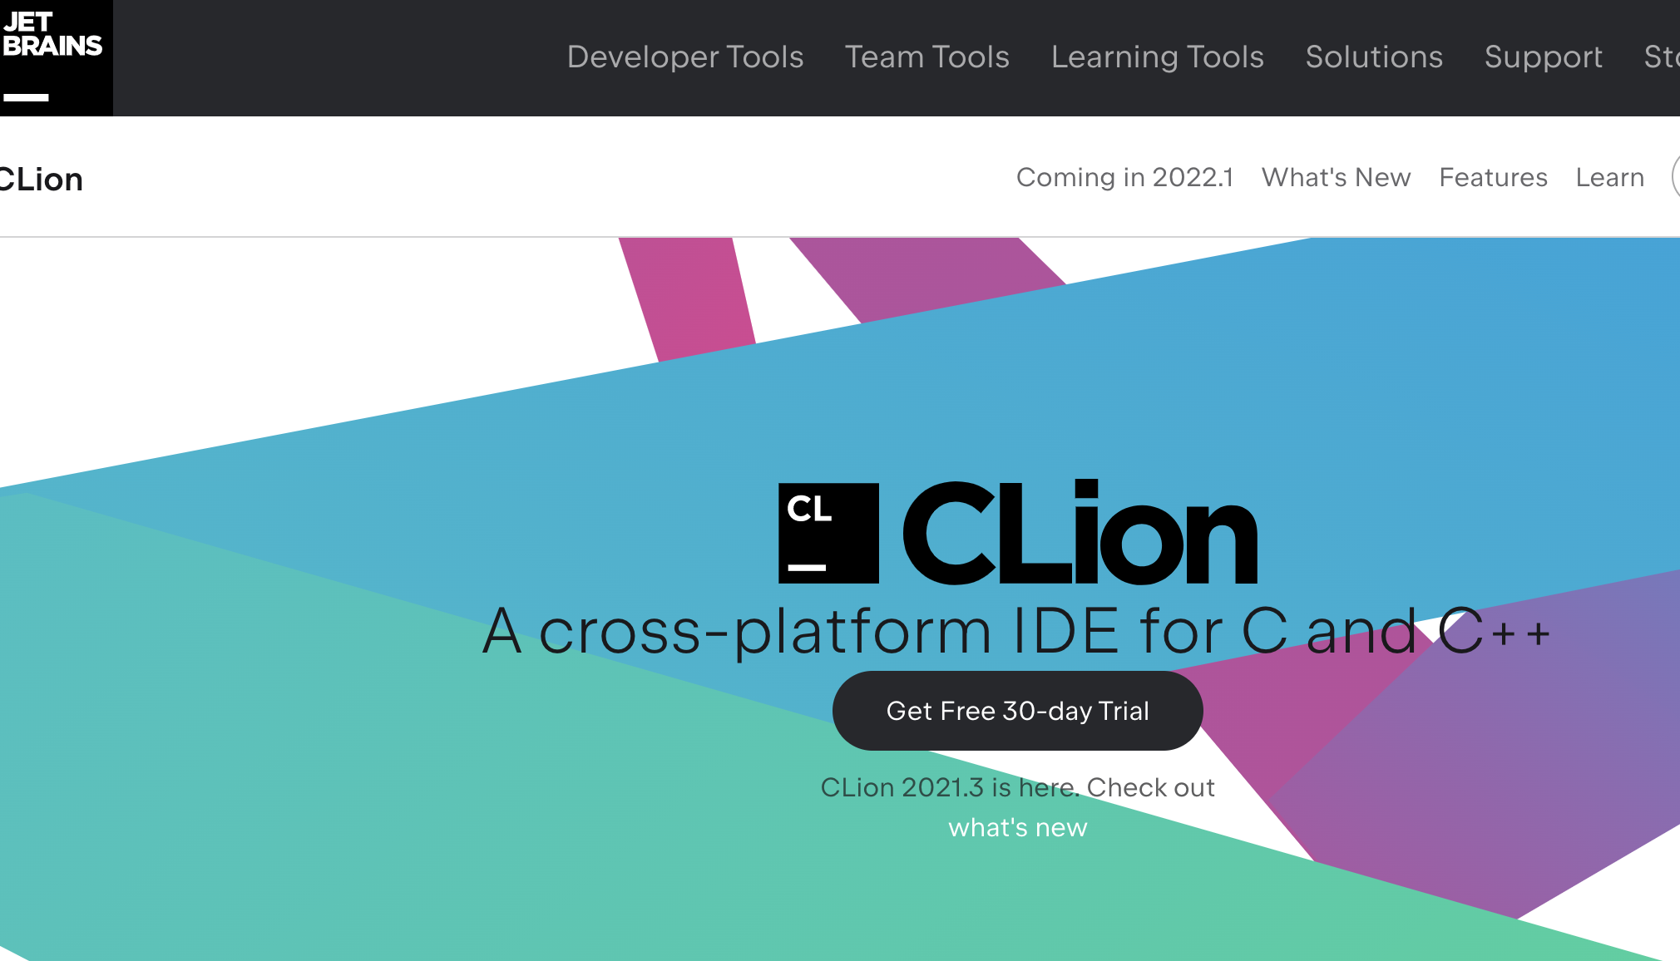
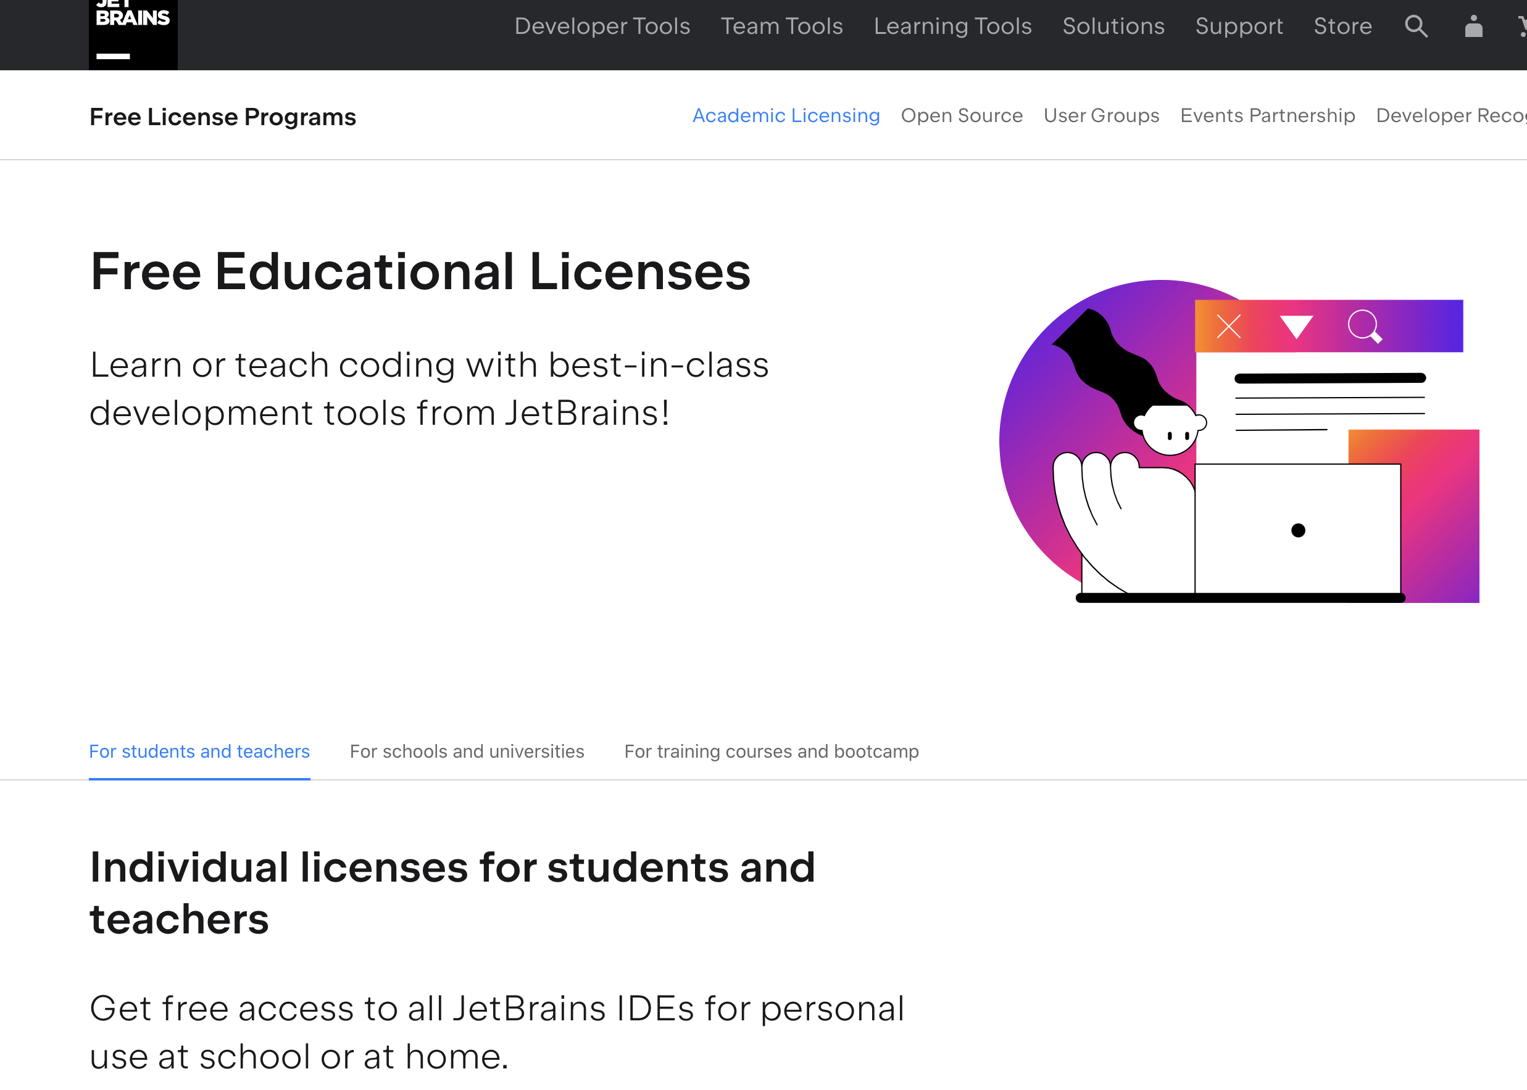
Editor: IDE
It’s Free!
https://www.jetbrains.com/clion/
https://www.jetbrains.com/community/education/#students
Demo!

Slide 34

Editor: IDE
But what about VS Code?
Won’t be used by instructor
You can still use it as long as submission test pass

Slide 35


Editor: Vim (Linux)
Available on (pretty much) all OS
Website in 80s, but probably the best editor you’ll have in your life
We use it to debug on Linux (only) if
Your submission has test failure, AND
That same failure doesn’t happen on your dev machine
Yes, you can choose to only use this for the course (optional)

Slide 36
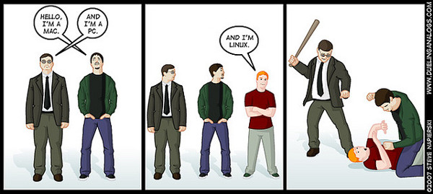
OS: Windows, OS, Linux
Normal coding
Either is fine (CLion)
Homework submission & grading
Linux, Ubuntu, 18.04, [defined here]
Available from Cloud Computing Platforms (e.g. AWS)
There will be demo this and next week on how to use this.

Slide 37
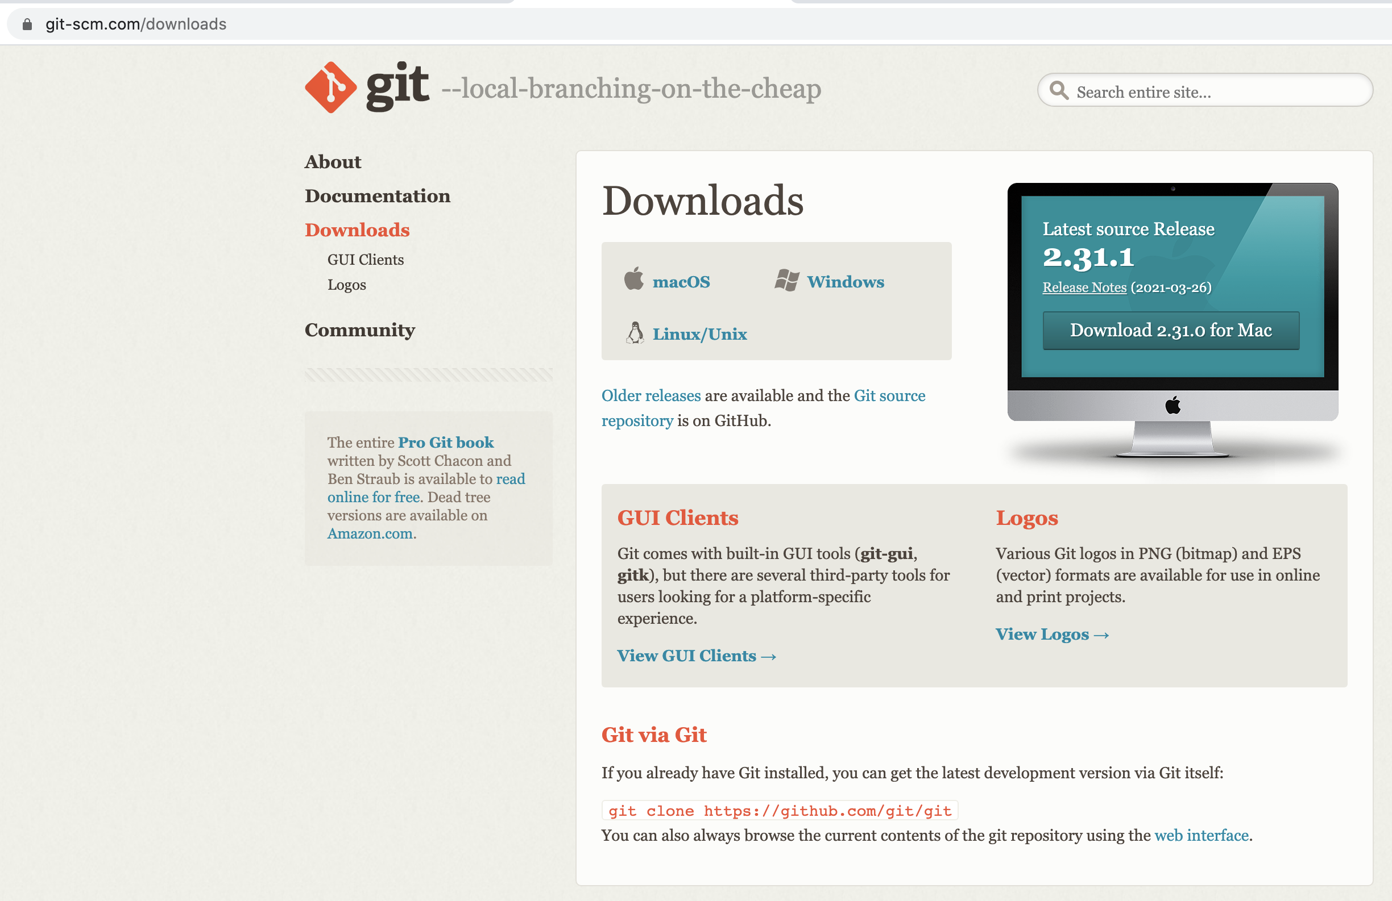
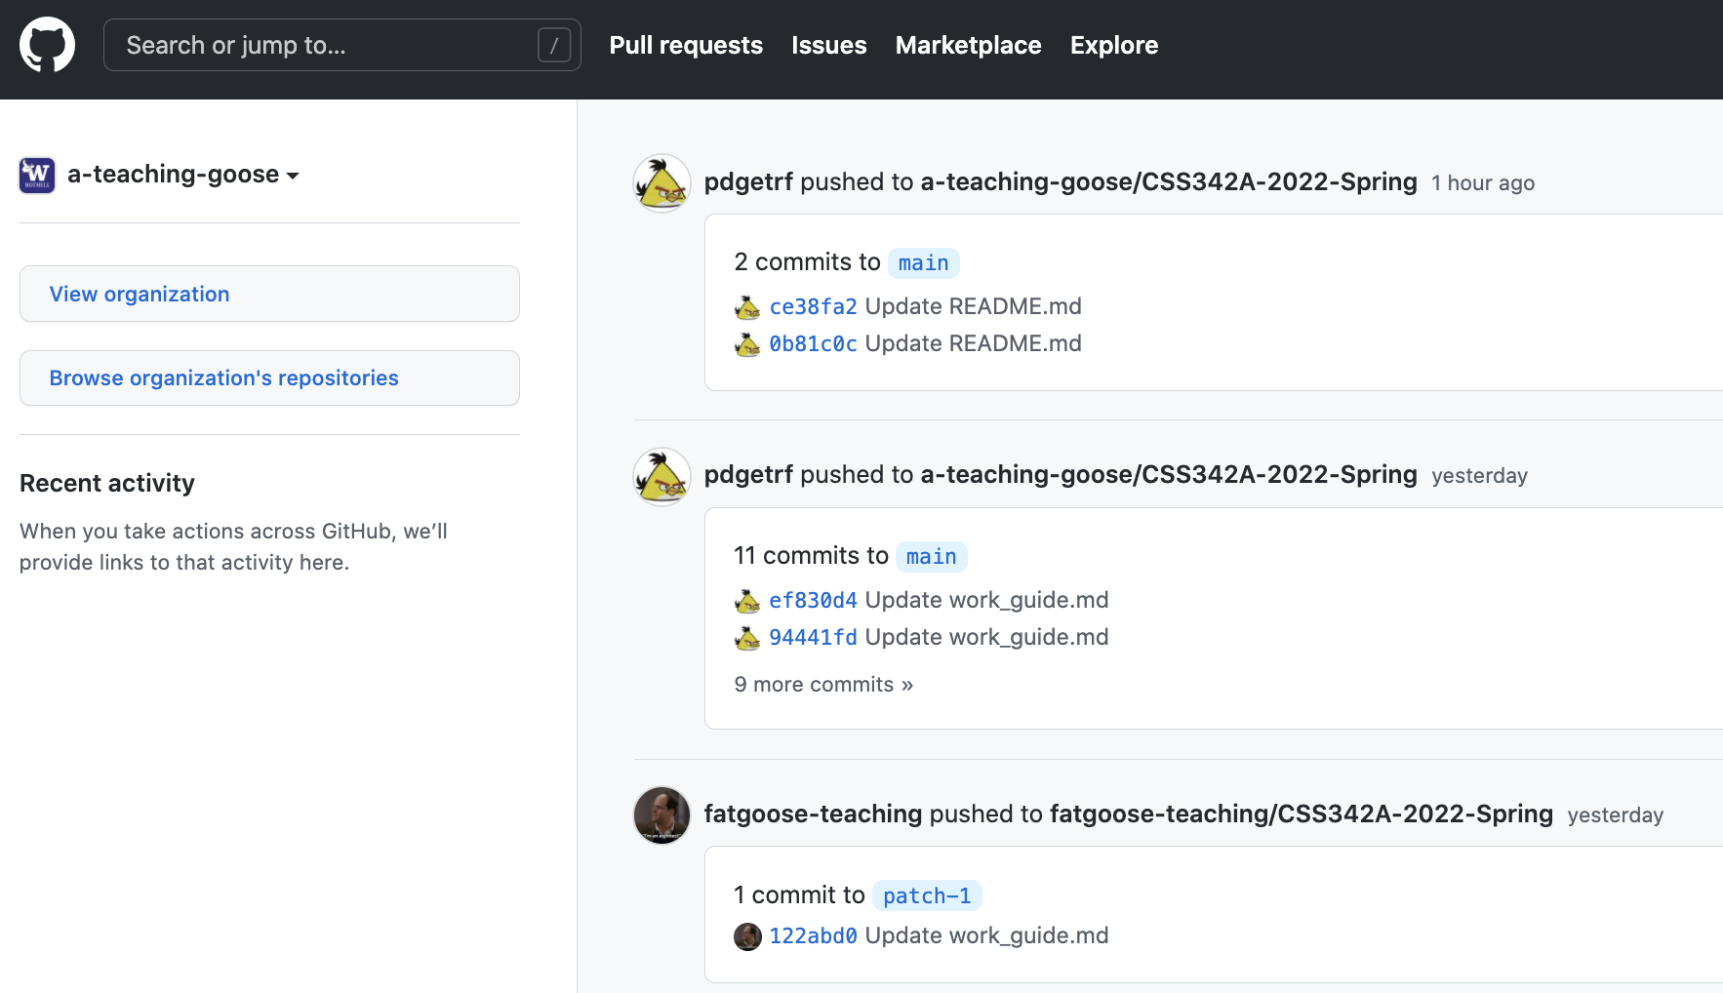
Git & GitHub
Git:
Keep versions of your code, on your machine
Each “version” is call a commit
You can have multiple branch of commits
https://git-scm.com/downloads
GitHub: Keep git repository online
https://github.com/

Slide 38

Source Control: Branch
Commit 1
Commit 2
Commit 3
Commit 6
Merge, Commit 7
Master branch
another branch
Commit 4
Commit 5

Slide 39




Push
Pull

Slide 40
Pull
Push

Slide 41
Friday Topics
C++ Basics
Test Driven Development Intro
Git and GitHub
Homework

Slide 42


Action Items (TODOs) Before Friday
Create your GitHub account
Join the 342A Discord channel and GitHub group
Install CLion
Clone and load homework 1 code in your IDE (CLion)
Make sure homework 1 code can compile and run in your IDE
Create a new branch for homework 1 in IDE
Watch this video (15 min)

Slide 43
Code tonight will be provided after class

Slide 44
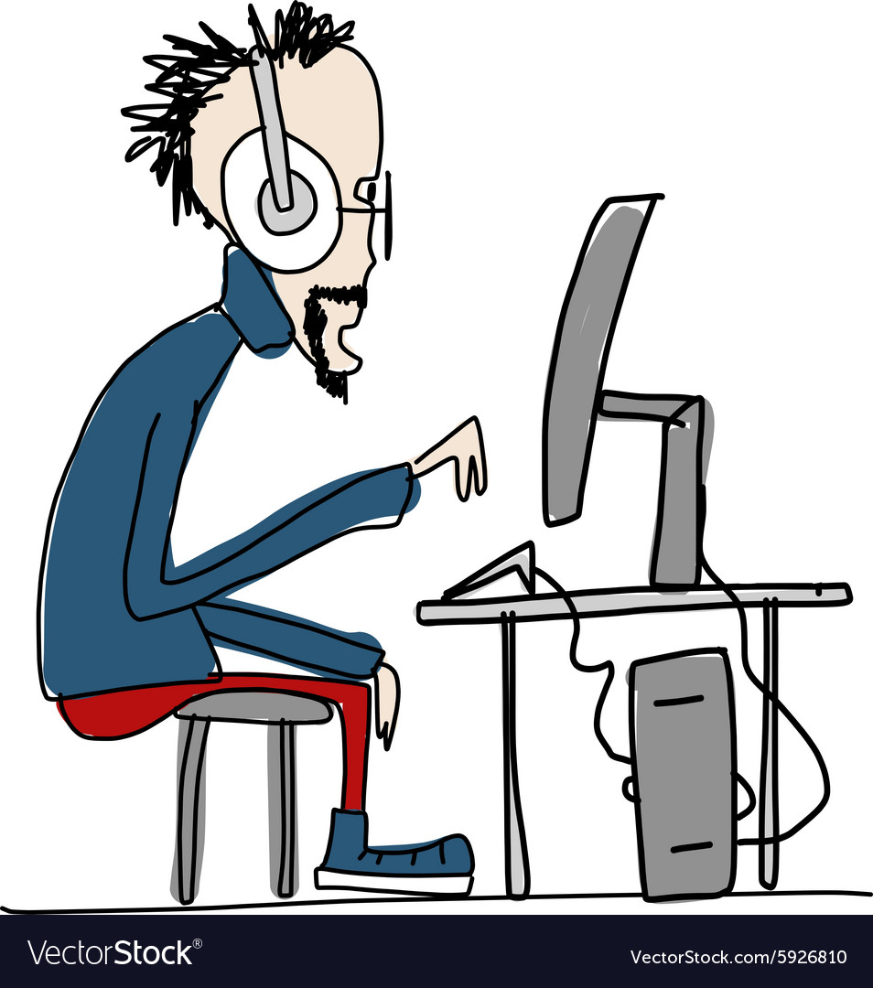
Demo

Slide 45
Today
C++ Basics
Debugging
Test Driven Development Intro (Next Wednesday)
Homework (the coding part)
Submission will be discussed next Wednesday

Slide 46
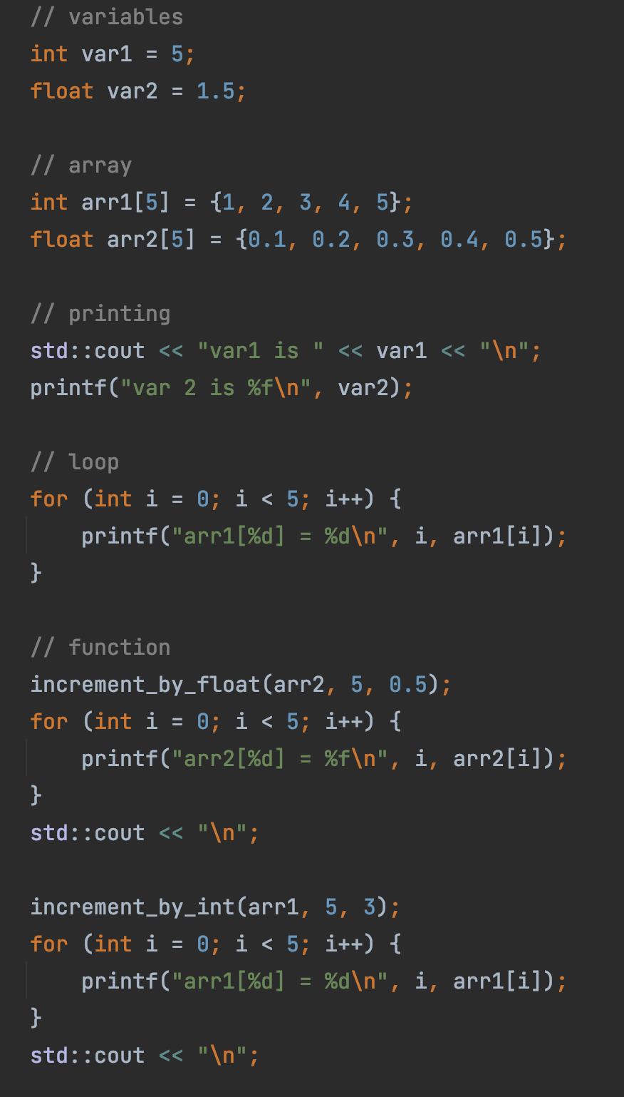
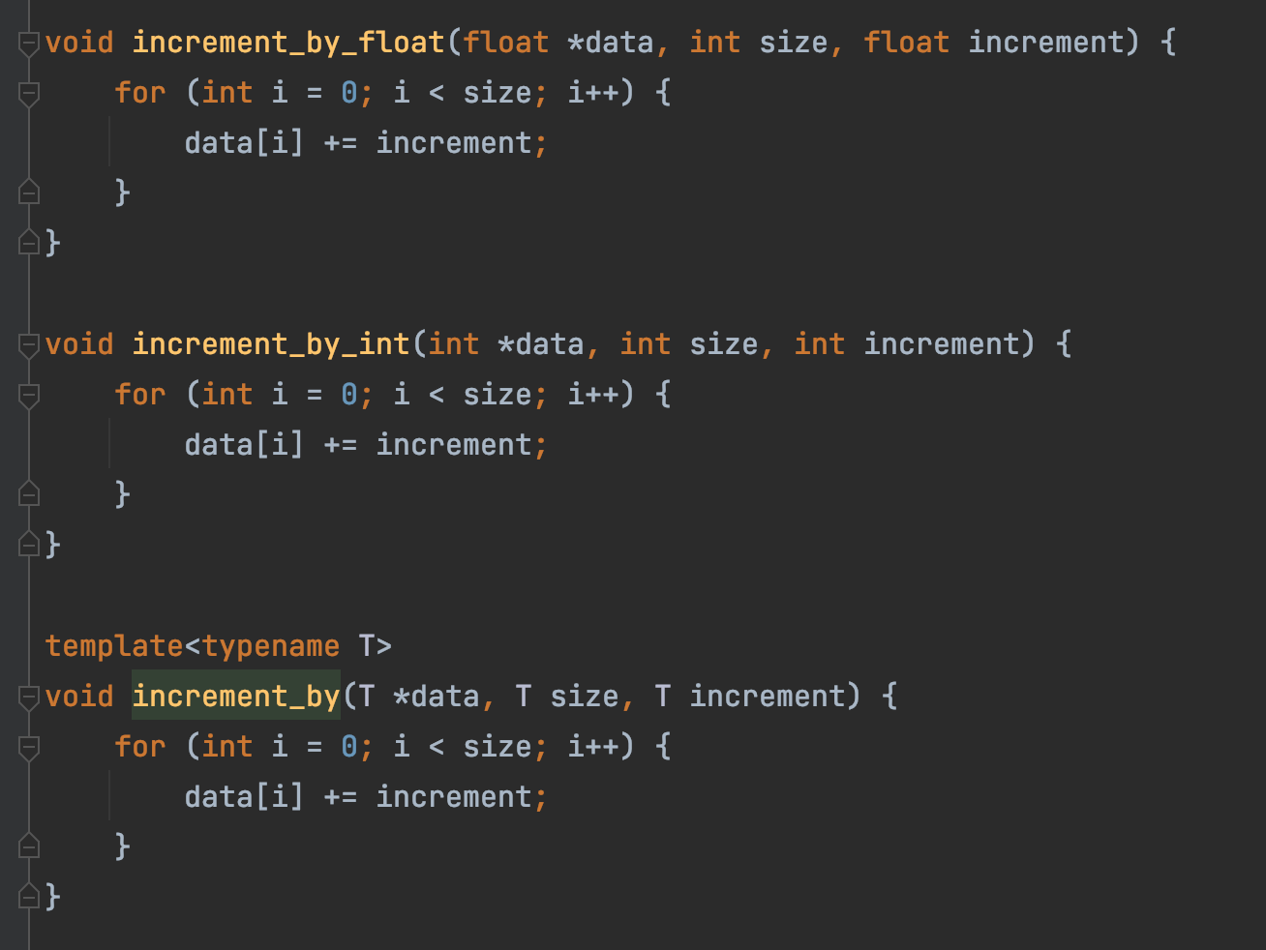
C++ Basics
Code here

Slide 47
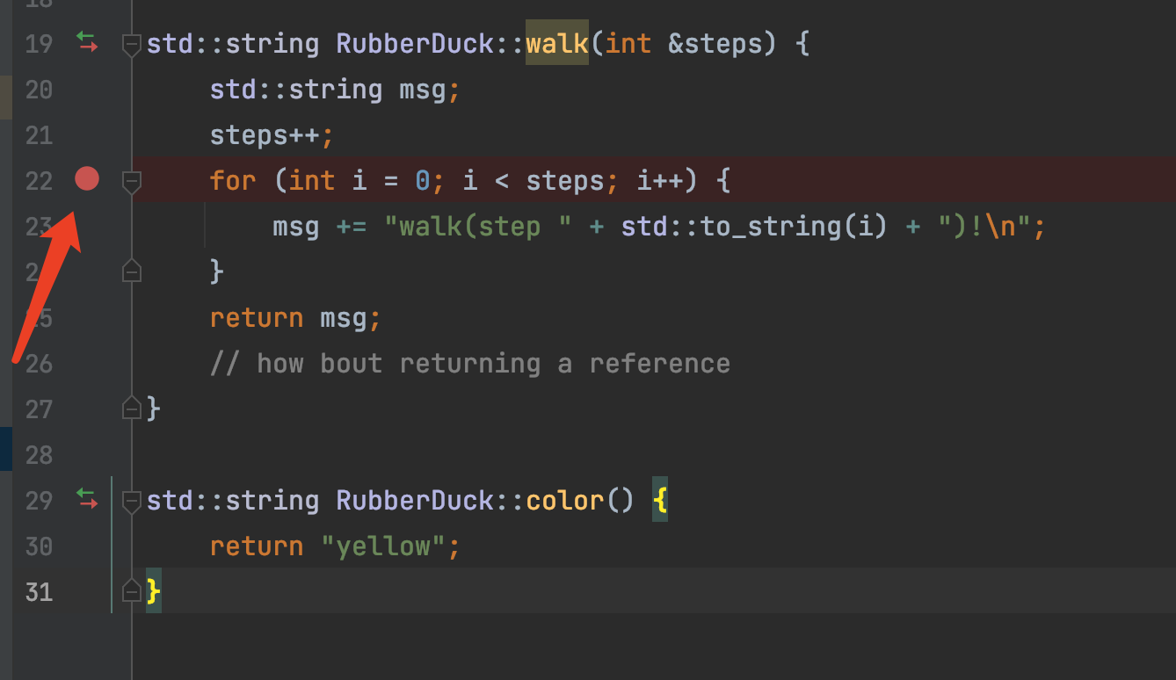
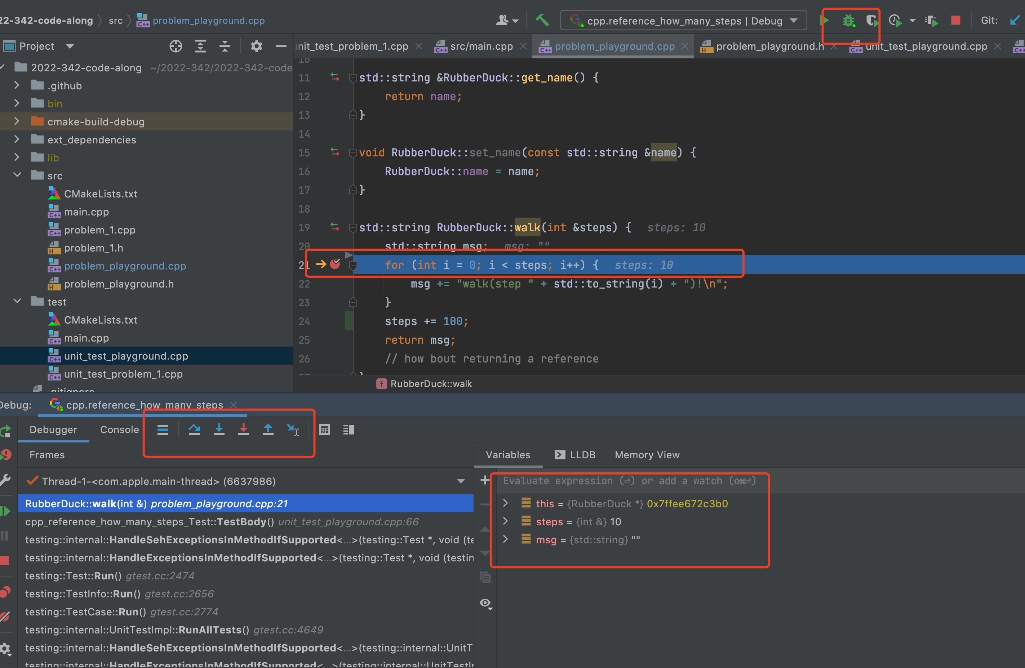
Debugging
Breakpoint
Step in
Step over
Read Variable

Slide 48
Data
Java
C++

Slide 49

Memory
Data
Memory (Storage)
Computer Memory
0
8
Data
Memory Address
16
32
… …

Slide 50
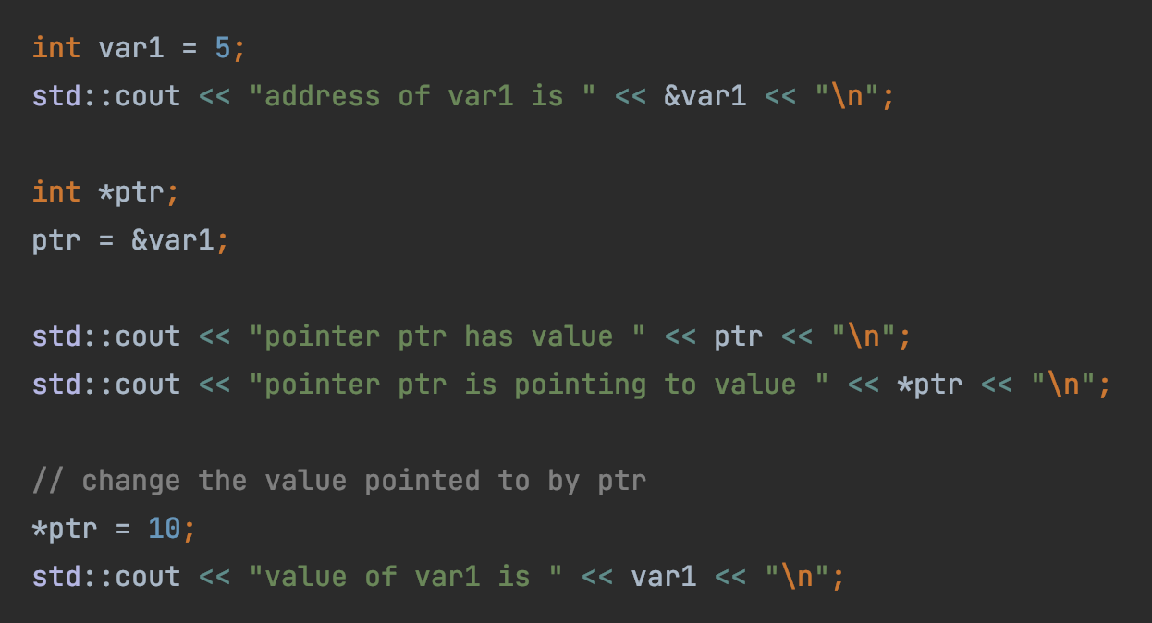

Pointer
Hexadecimal Address
0x0
1 byte (8 bits)
0x8
0x10
0x18
Var1 (5)
sizeof(int)
4 bytes
… …
ptr (0x18)
sizeof(int*)
8 bytes
Code here

Slide 51
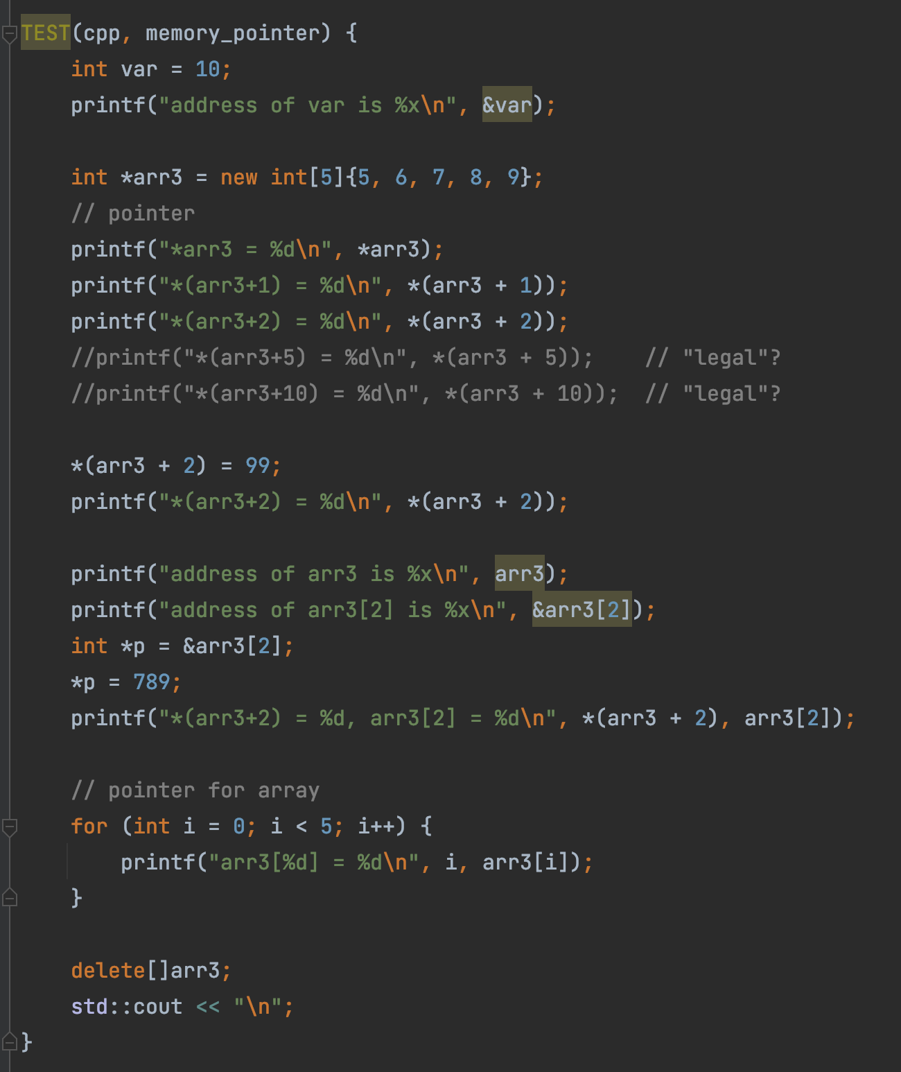
Pointer
Code here

Slide 52
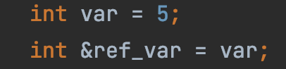
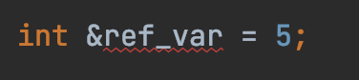
Reference
Hexadecimal Address
0x0
1 byte (8 bits)
0x8
0x10
0x18
Reference: a label (new name) to an existing variable
… …
Var1 (5)
ref_var
What’s wrong with this?

Slide 53
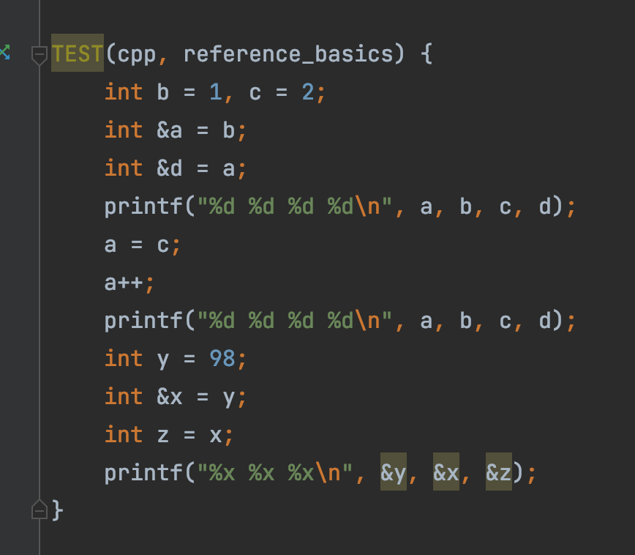
Reference
!!Exam Material!!
Code here

Slide 54

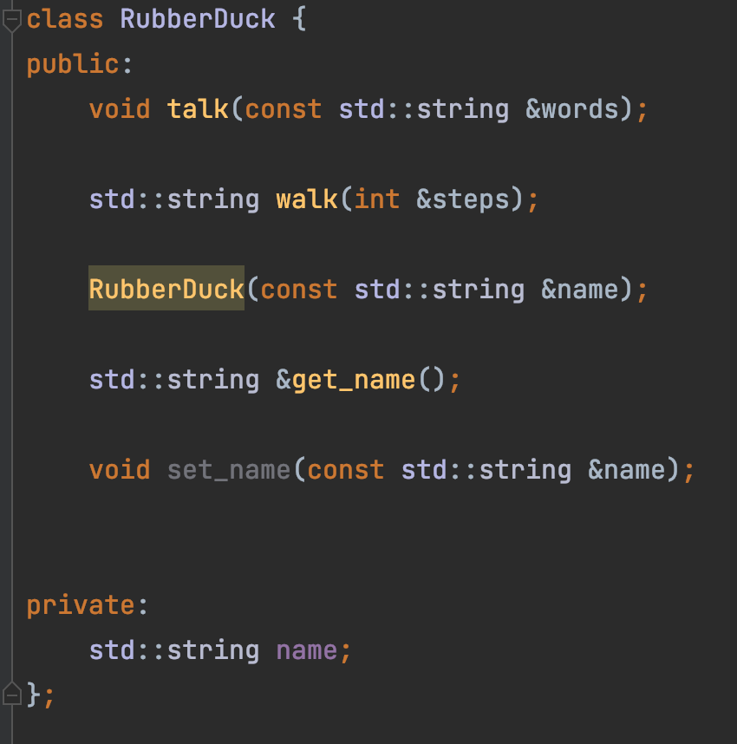
OOP Class
Code here

Slide 55
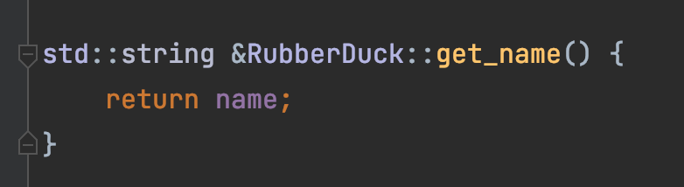
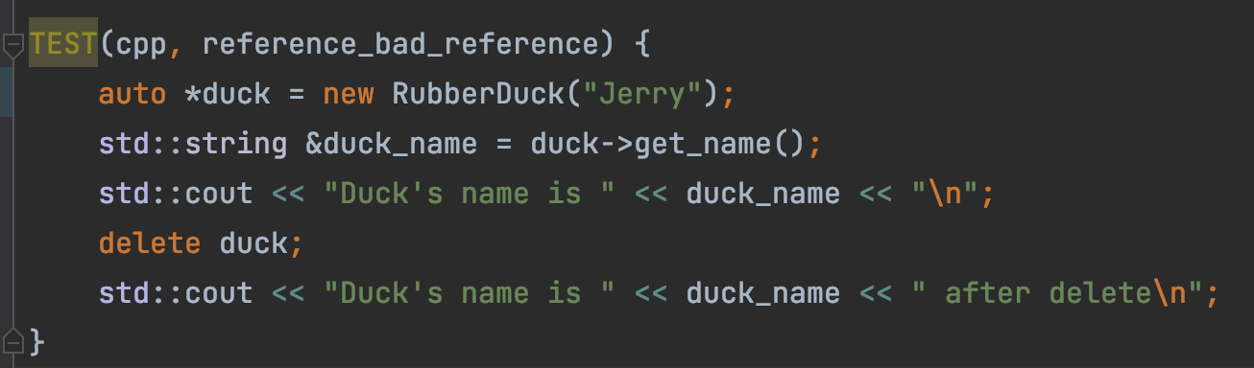
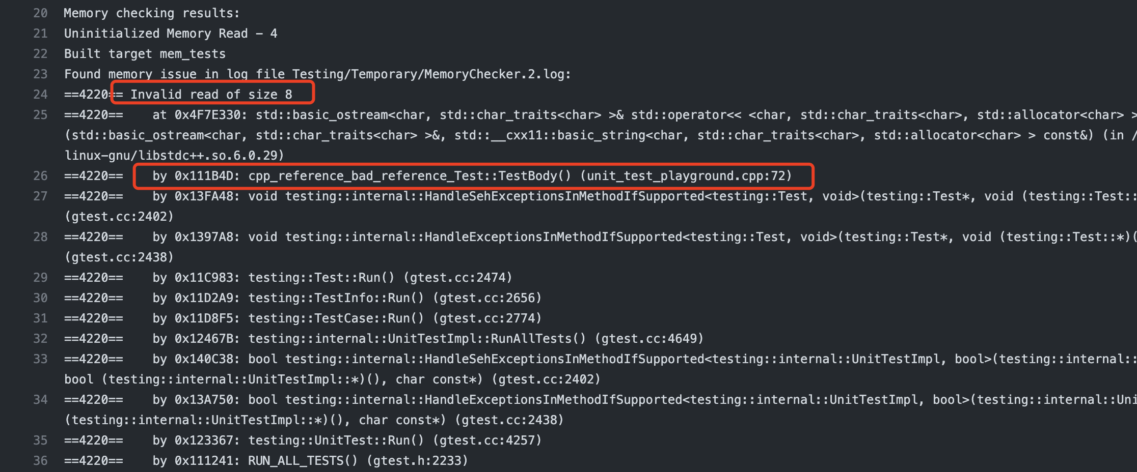
Bad Reference
Why?
See full log here

Slide 56
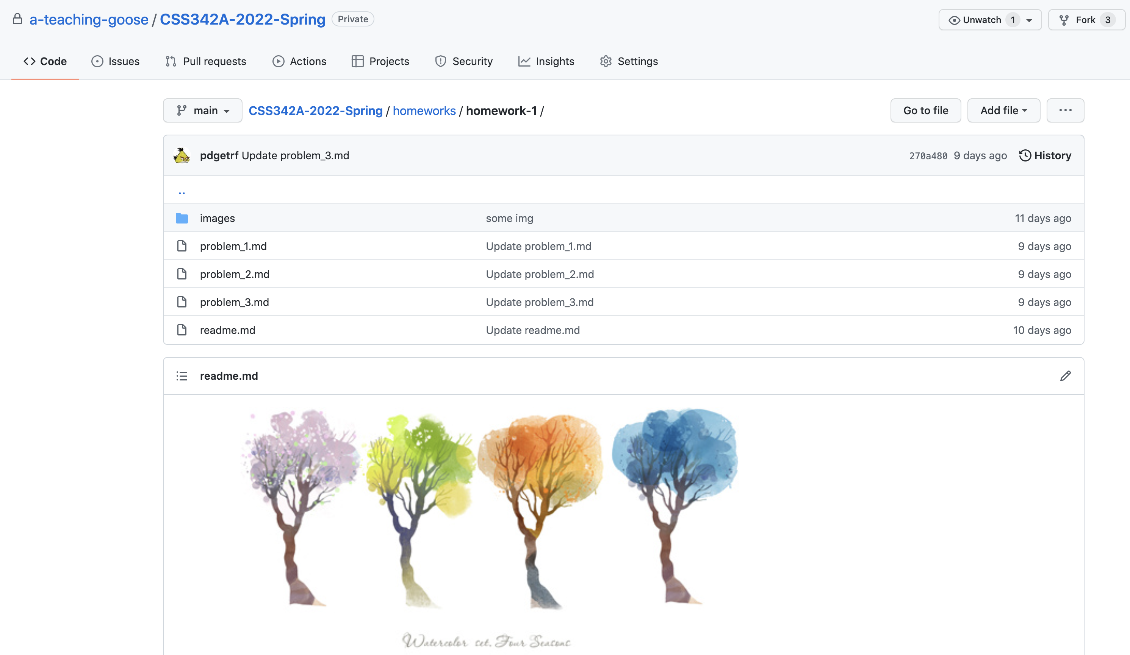
Homework 1
https://github.com/a-teaching-goose/CSS342A-2022-Spring/tree/main/homeworks/homework-1

Slide 57

Binary Search
Target: 14
1
3
5
7
9
10
12
12
14
14
18

Slide 58
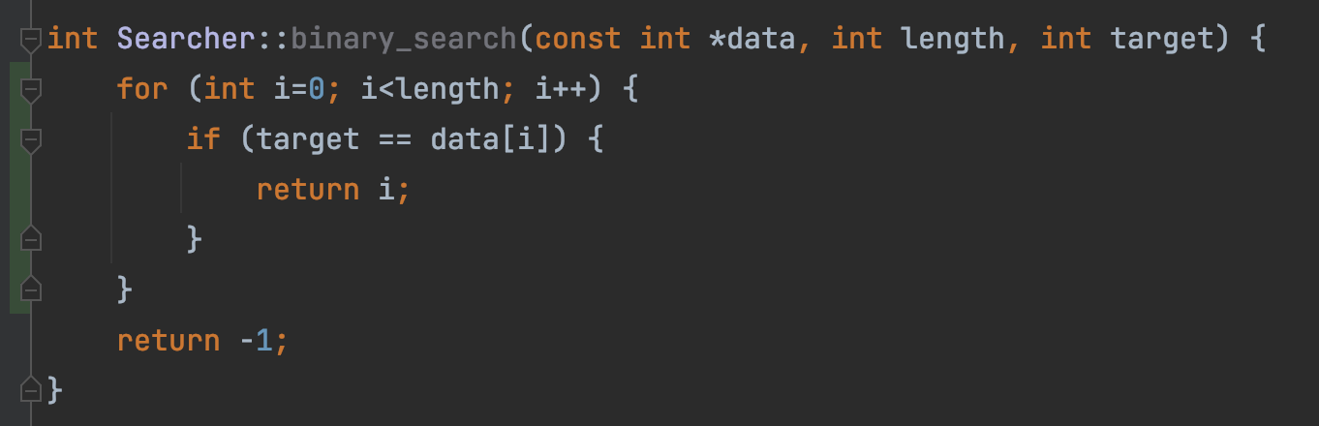
This is linear search, not binary search
“But test passed!”
Test passed
➔ ?
Code is correct
Test failed
➔ ?
Code is wrong

Slide 59
Bubble Sort
9
1
8
7
3
1
9
8
7
3
Round 1
1
8
9
7
3
1
8
7
9
3
1
8
7
3
9

Slide 60
1
8
7
3
9
1
8
7
3
9
Round 2
1
7
8
3
9
1
7
3
8
9

Slide 61
1
7
3
8
9
Round 3
1
7
3
8
9
1
3
7
8
9

Slide 62
1
3
7
8
9
Round 4
1
3
7
8
9

Slide 63
1
3
7
8
9
Round 5
1
3
7
8
9

